Slide 1
MUSIC EFFECTS TO MENTAL HEALTH
DEPRESSION
ANXIETY
INSOMNIA
IMPROVE
NO EFFECT
WORSEN

Slide 2

MUSIC
Listening to music has real impact to Mental Health.
Positive Effects
Daily Listening of Music

Slide 3
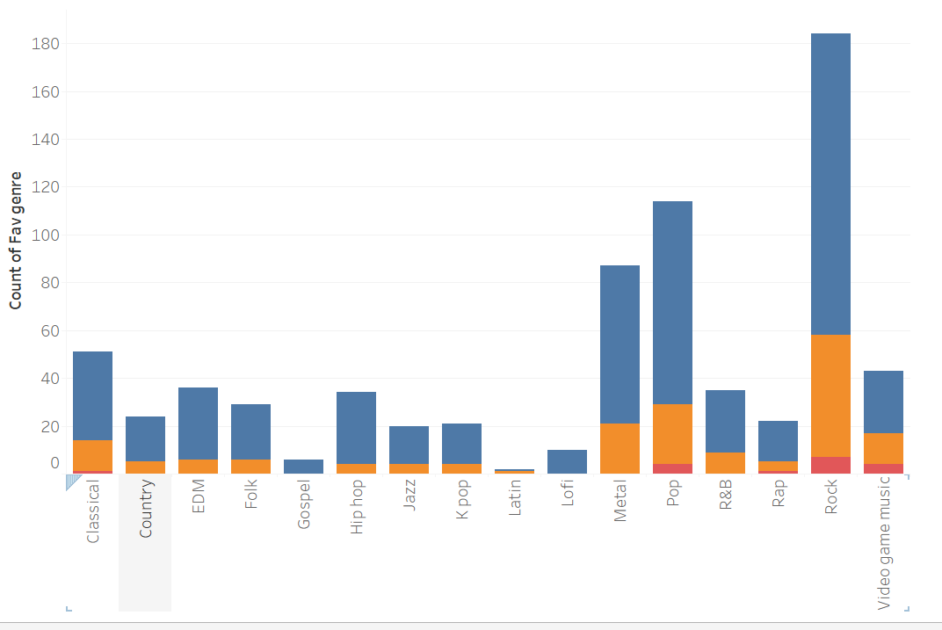
Rock Music
is the most popular

Slide 4
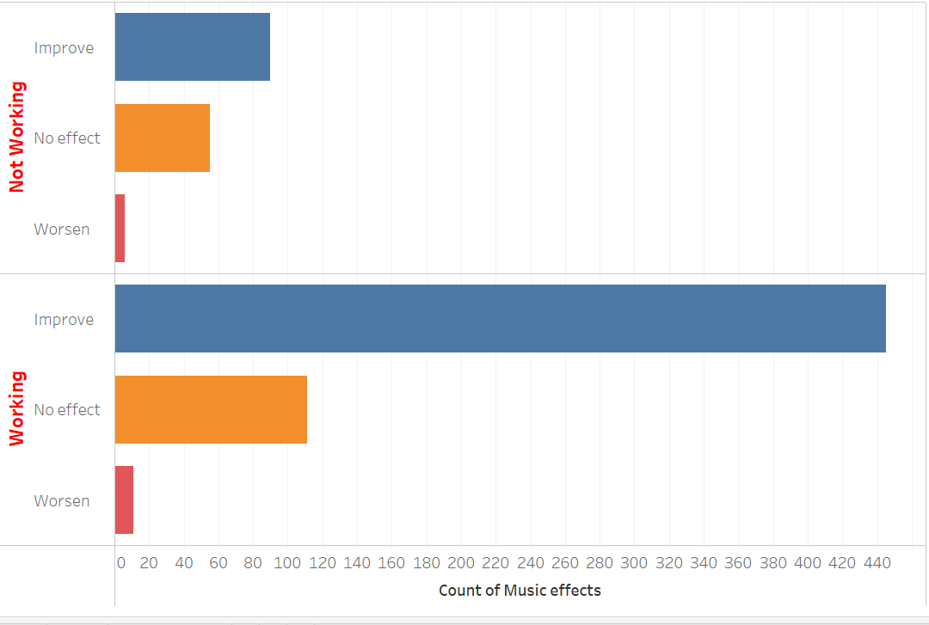
MOST IMPROVEMENT
IS BY THOSE LISTENING TO
MUSIC WHILE WORKING.

Slide 5
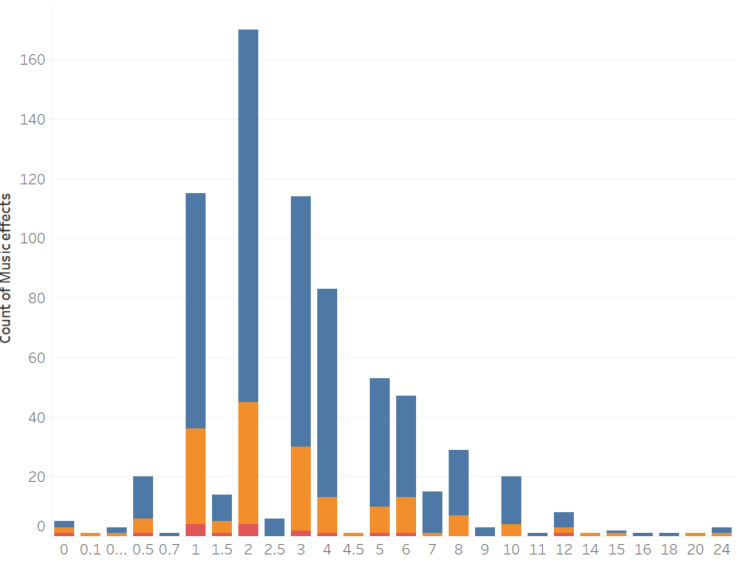
Those who listened to music on an average of 2hours a day were the most popular and most improved.
Number of persons
Number of hours a day

Slide 6
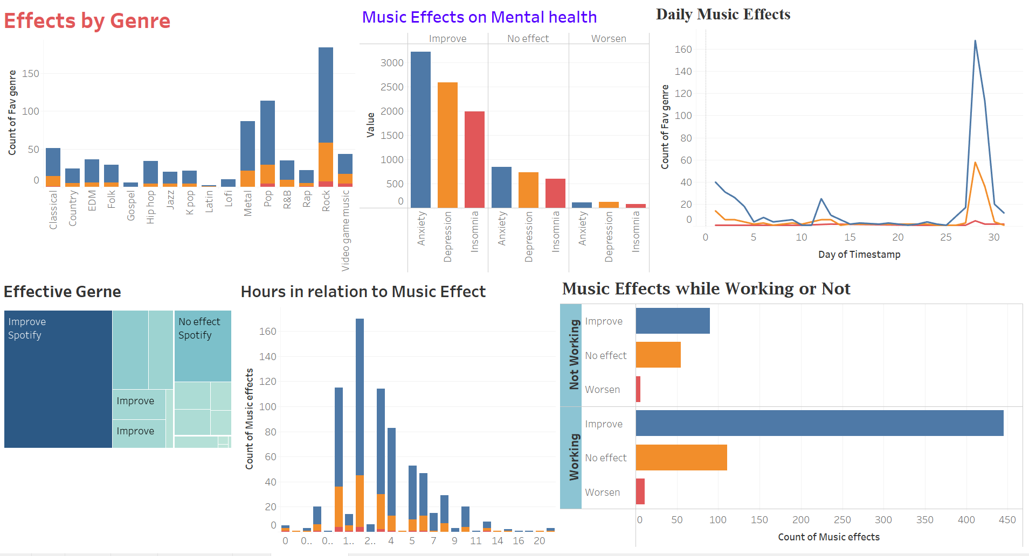

Slide 7
Persons with Anxiety were did improve the most.
Spotify was the most used.
At the end month people listened a lot.

